Slide 1


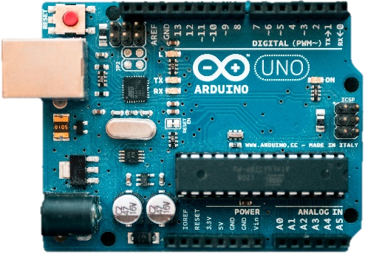
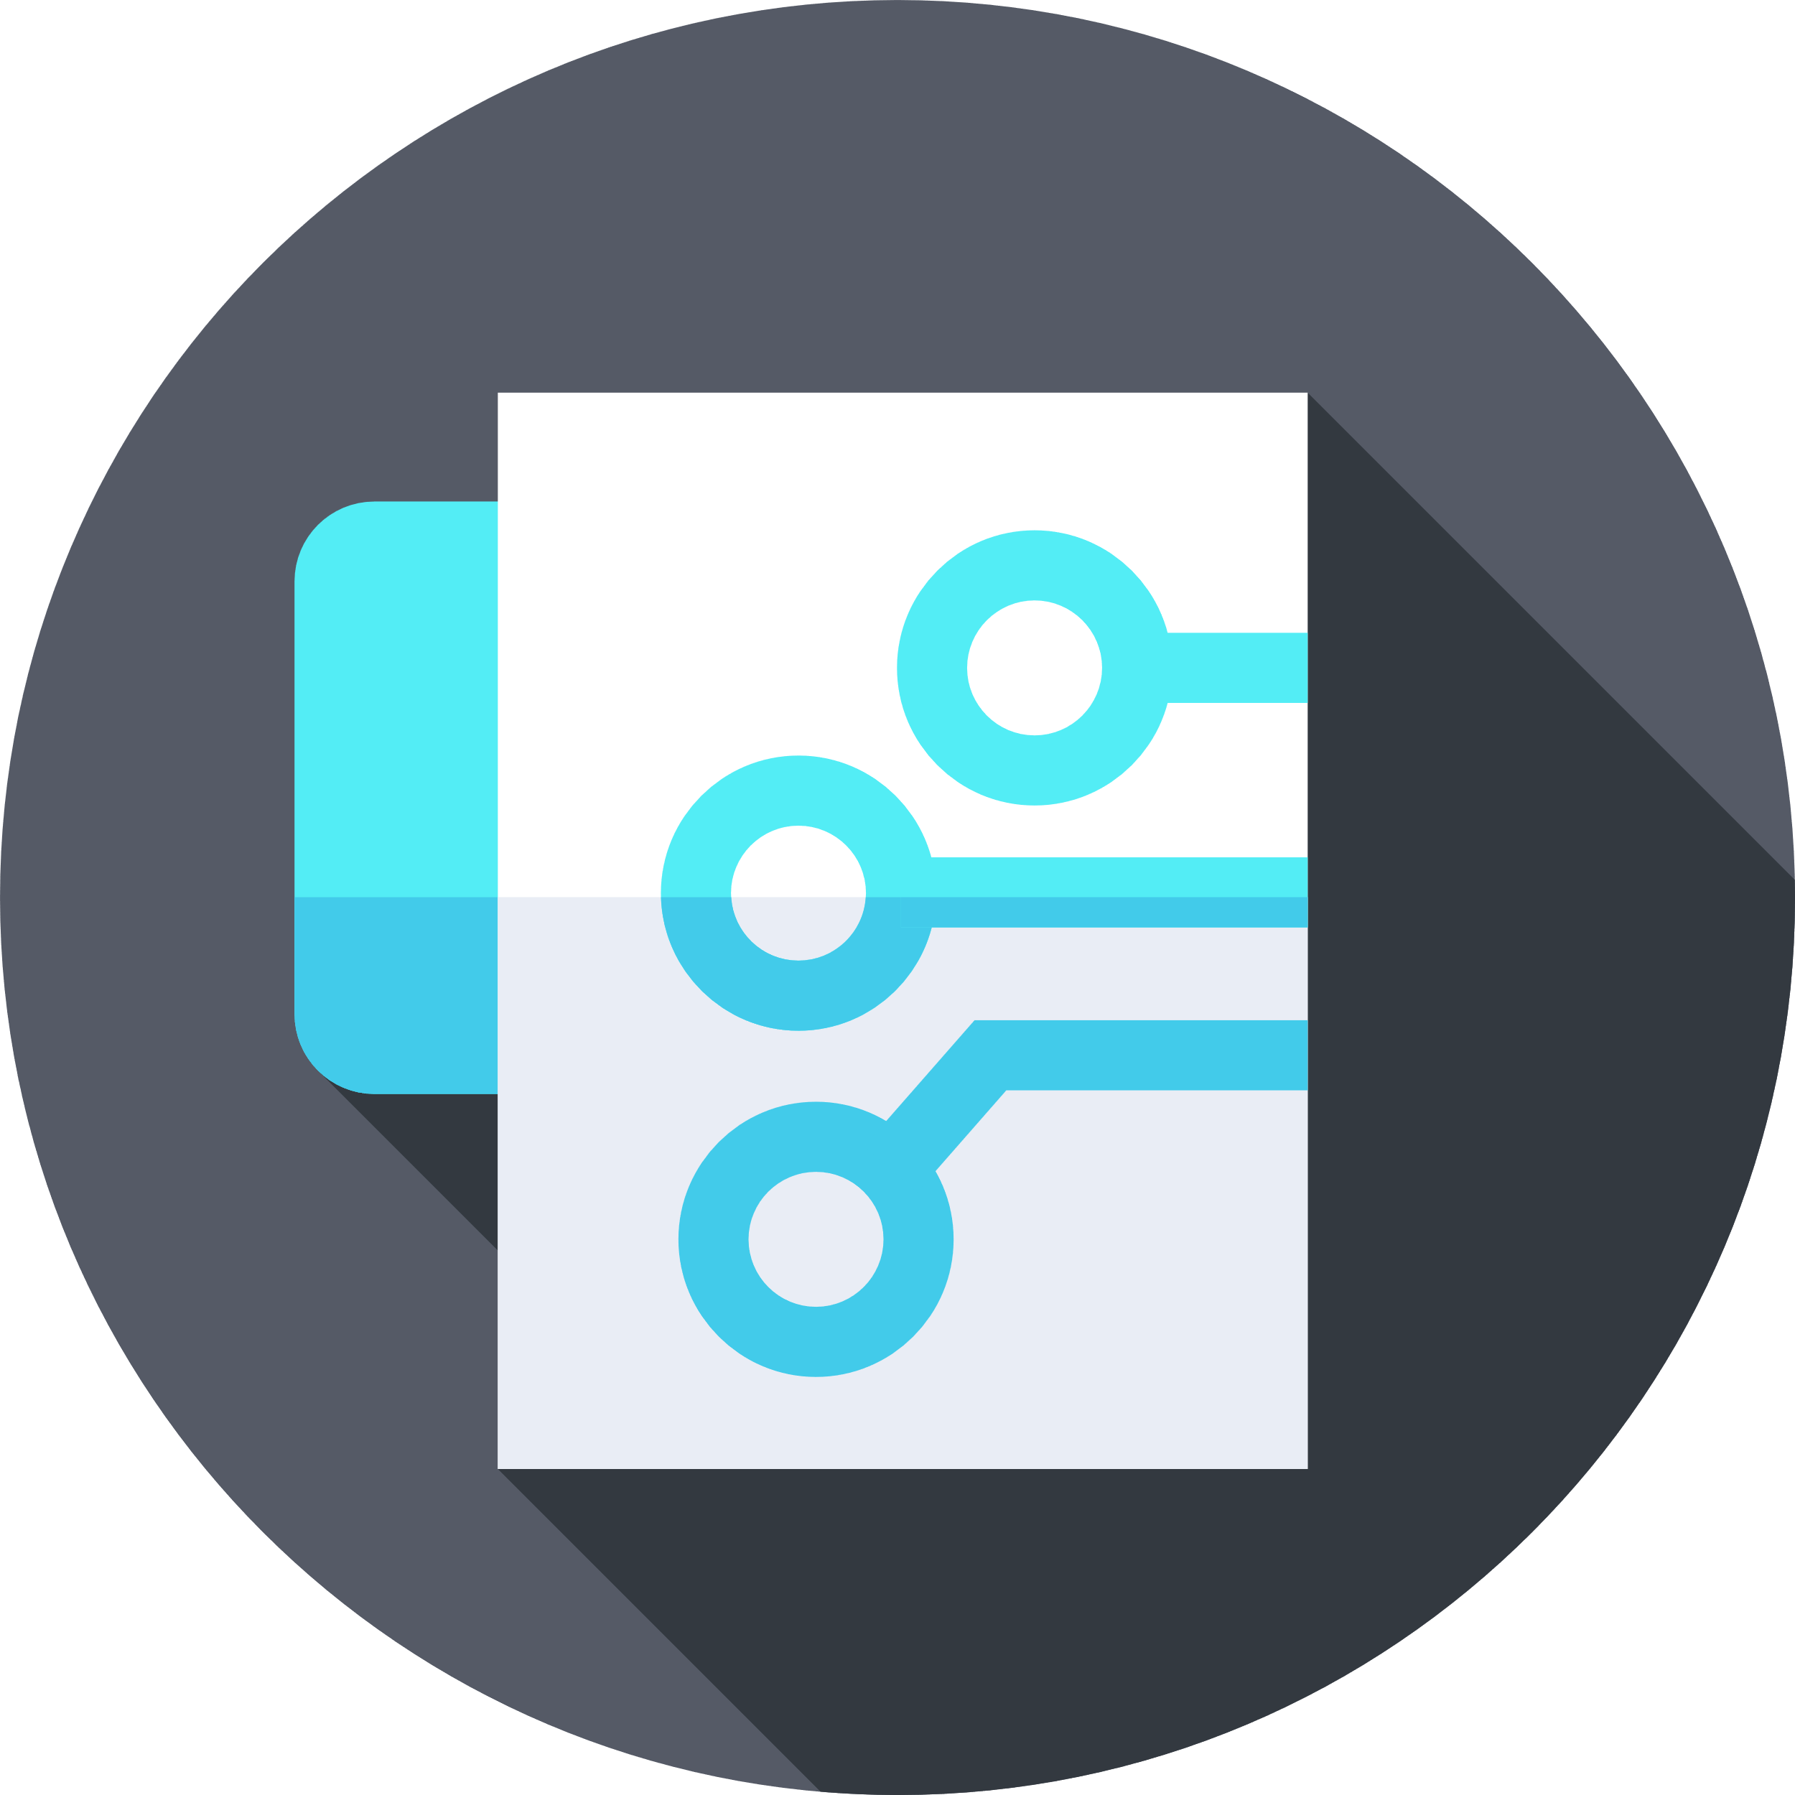
Internet
Internet
Of
Of
Things
Things
Instructor: Aman Singh

Slide 2
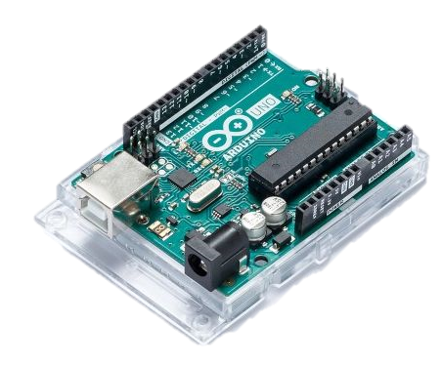
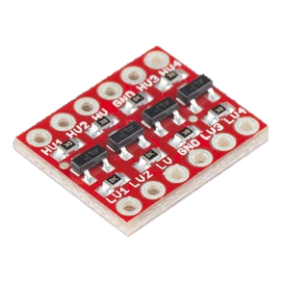
Inputs and outputs
Arduino boards comes with several digital and analog pins aka GPIO pins. Which can be programmed to work as an input or output for the Arduino.
These pins works on 3.3v or 5v DC. Arduino boards or Arduino UNO specifically works on 5v DC logic.
There are several boards which work on 3.3v DC logic like NodeMCU.
To convert 5v logic to 3.3v or vice-versa we will need a Logic Level Converter.

Slide 3
Analog and Digital
Voltage
Time
Voltage
Time

Slide 4
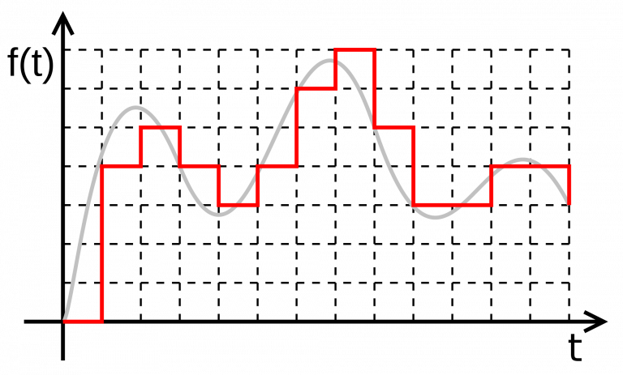
Sampling

Slide 5
Pulse Width Modulation
Pulse width modulation, or PWM, is a technique for getting analog results with digital means. Digital control is used to create a square wave, a signal switched between on and off.
This on-off pattern can simulate voltages in between the full Vcc of the board (e.g. 5V on UNO) and off (0 volts) by changing the portion of the time the signal spends on versus the time that the signal spends off.
The duration of “on time” is called the pulse width. To get varying analog voltages, you can change, or modulate, that pulse width. If you repeat this on-off patter fast enough with an LED for example, the result is as if the signal steady voltage between 0 and Vcc controlling the brightness of the LED.

Slide 6
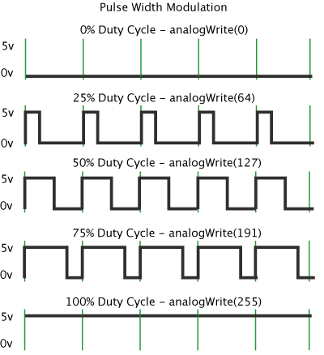
Pulse With Modulation
The green lines represents a regular time period. This duration or period is the inverse of the PWM frequency. In other words, with Arduino’s PWM at about 500Hz, the green lines would measure 2 milliseconds each.
A call to analogWrite() is on a scale of 0-255 such that analogWrite(255) requests a 100% duty cycle (always on), and analogWrite(127) is a 50% duty cycle (on half the time) for example.

Slide 7
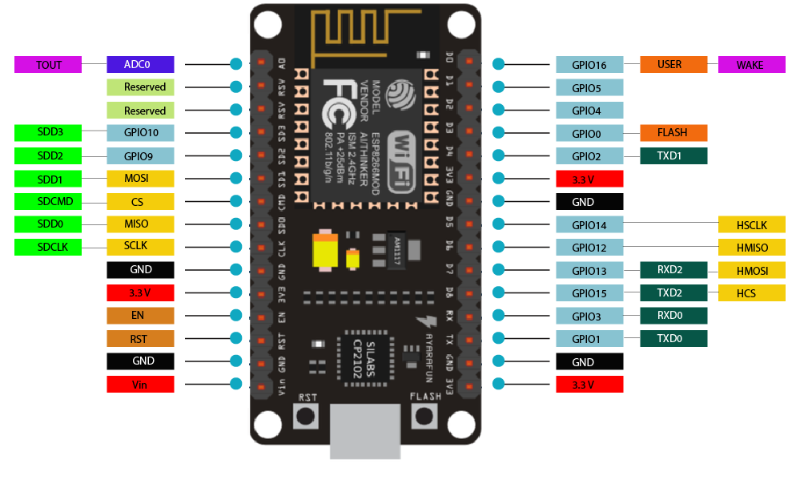
NodeMCU Pinout

Slide 8
Let’s Code
Working with Light Sensor (LDR)
Taking Digital inputs from push button
Controlling Brightness of LED with PWM
Working with Potentiometer

